Slide 1

Dangerous with Data
Project Manager: Desthy Matouba
Research Lead: Imane Bourzgui
Lead Programmer: Yann Ulysse

Slide 2
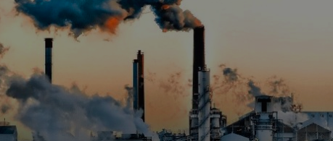
Air Pollution Analyses in the US

Slide 3
Background and Focus of this Study
Air pollution is the emission of harmful substances, pollutants, to the atmosphere.
Toxic air pollutants of concern :
Sulphur dioxide (SO₂): Forms in the air by the burning of fossil fuels by power plants and other industrial facilities
Nitrogen dioxide (NO₂): Forms from vehicle emission and power plants. Can aggravate respiratory diseases
Ozone (O₃): Harmful to lungs and is the main constituents of smog/haze
Carbon monoxide (CO): Emitted by vehicles that burn fossil fuels
Particulate matter (PM2.5) (small suspended particles of varying sizes): Tiny bits of dust, dirt, smoke that hang in the air. Can penetrate into the lungs and cause breathing problems

Slide 4
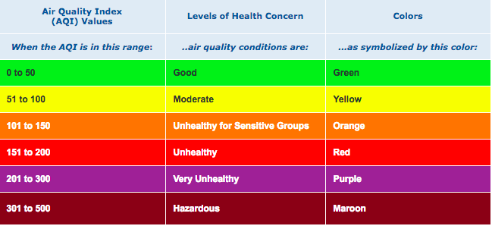
AQI: Air Quality Index
A measure of how clean or polluted the air is in a given time and location
Identifies any health risks to individuals

Slide 5
APPROACH

Slide 6
Overall Questions
What are some of the major influences on Air pollution and what are some of the effects of air pollution?

Slide 7
Analysis Questions
What are the most polluted countries in the world?
What are the trends of major air pollutants in the United States over time?
Do pollutant levels affect individual’s health?
(Are there effects of high pollutant levels on the following?)
Mortality Rates
Asthma
4. How is US GDP trending over time compared to major air pollutants?

Slide 8
Sources, Datasets, Tools
Sources and Datasets
Open Data Soft: World Pollution dataset https://public.opendatasoft.com/explore/dataset/worldwide-pollution/table/?disjunctive.country&disjunctive.filename
Kaggle: US Pollution dataset; https://www.kaggle.com/sogun3/uspollution
Socrata Sandbox: Asthma dataset; https://bah.demo.socrata.com/Government/DATASET-Asthma-Chronic-Disease-Indicators/neii-ukbv
Center for Disease Control: https://www.cdc.gov/asthma/most_recent_data.htm
Bureau of Economic Analysis GDP and Personal Income (Regional Data):
https://apps.bea.gov/iTable/index_regional.cfm
Environment Protective Agency: https://www.epa.gov/
Tools Used
Excel
Jupyter Notebook
Python
Google Maps API

Slide 9
World Air Pollution
“A heatmap is a visualization used to depict the intensity of data at geographical points. When the Heatmap Layer is enabled, a colored overlay will appear on top of the map. By default, areas of higher intensity will be colored red, and areas of lower intensity will appear green.”
The heatmap produces a neat visual that allows us to potentially make inferences on factors in regions around the world that cause them to have an overall higher concentration of pollutants

Slide 10
World Air Pollution
Created a heatmap using Google maps API
To created this heatmap we use three things.
Longitudes
Latitudes
Pollutant AQI values
Plotted geographical points with a heatmap layer and used AQI values as weight

Slide 11
What are the trends of major Air Pollutants in the United States over time?

Slide 12
Do air pollutants present health risks in the US?
Air pollution triggers respiratory illnesses (ie. Asthma)
Air pollution can make asthma symptoms worse and trigger attacks:
(symptoms: burning in lungs, wheezing)
The key air pollutants to affect asthma: Ground level Ozone and particulate matter

Slide 13
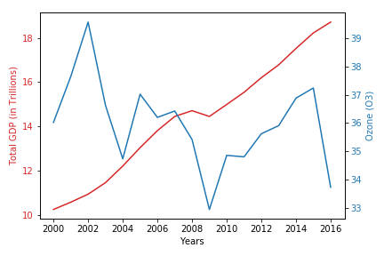
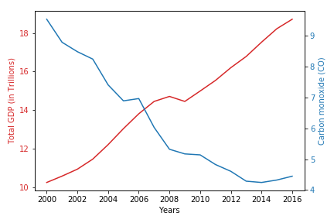
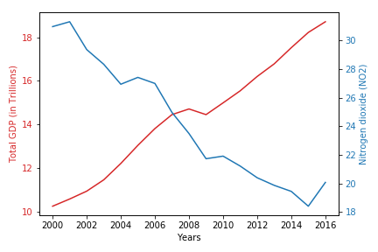
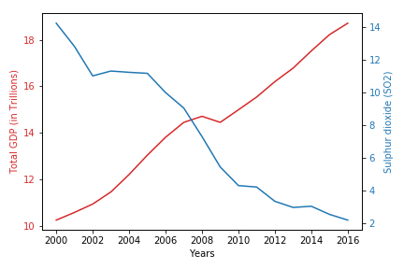
How is US GDP trending over time compared to major Air Pollutants?
US GDP is trending up from 2000 to 2016, while the major pollutants are trending down
The upward trends can be observed in industries such as “Mining, Oil and Gas Extraction”, “Manufacturing”, “Transportation and Warehousing”
According to the EPA, the Clean Air Act has been positive influence on the economy (Source)

Slide 14
Summary
Air Pollutant AQIs are going down over time, which is in line with Mortality counts’ downward trend over time
Based on the data, we have not observed a correlation between Asthma and Pollutant levels.
Based on the data, we do not find that US GDP has been negatively impacted by decreasing Air Pollutants AQIs

Slide 15
Other Factors to consider
Populations growth vs Pollution levels
Effect of vehicles on pollution levels
Effect of energy consumption on pollution levels
Effect of Pollution on other illnesses such as cardiovascular and lung cancer
Factors that make certain regions of the world more polluted than others

